Slide 1
BRITISH AIRWAYS VIRTUAL INTERNSHIP
SUBMITTED BY,
VISHAK KRISHNAN

Slide 2
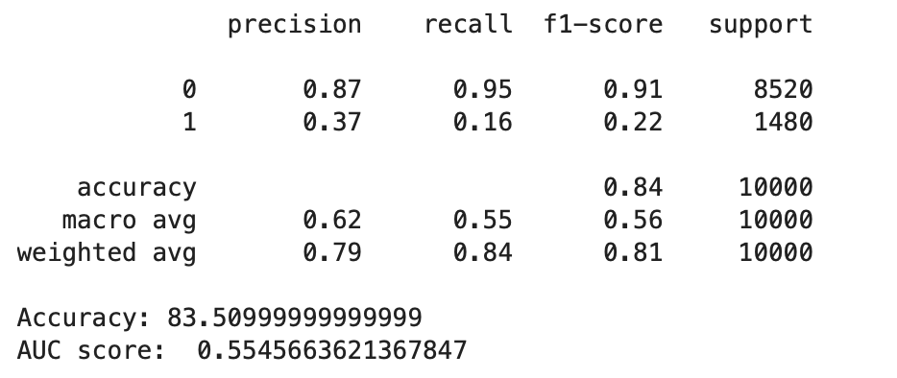
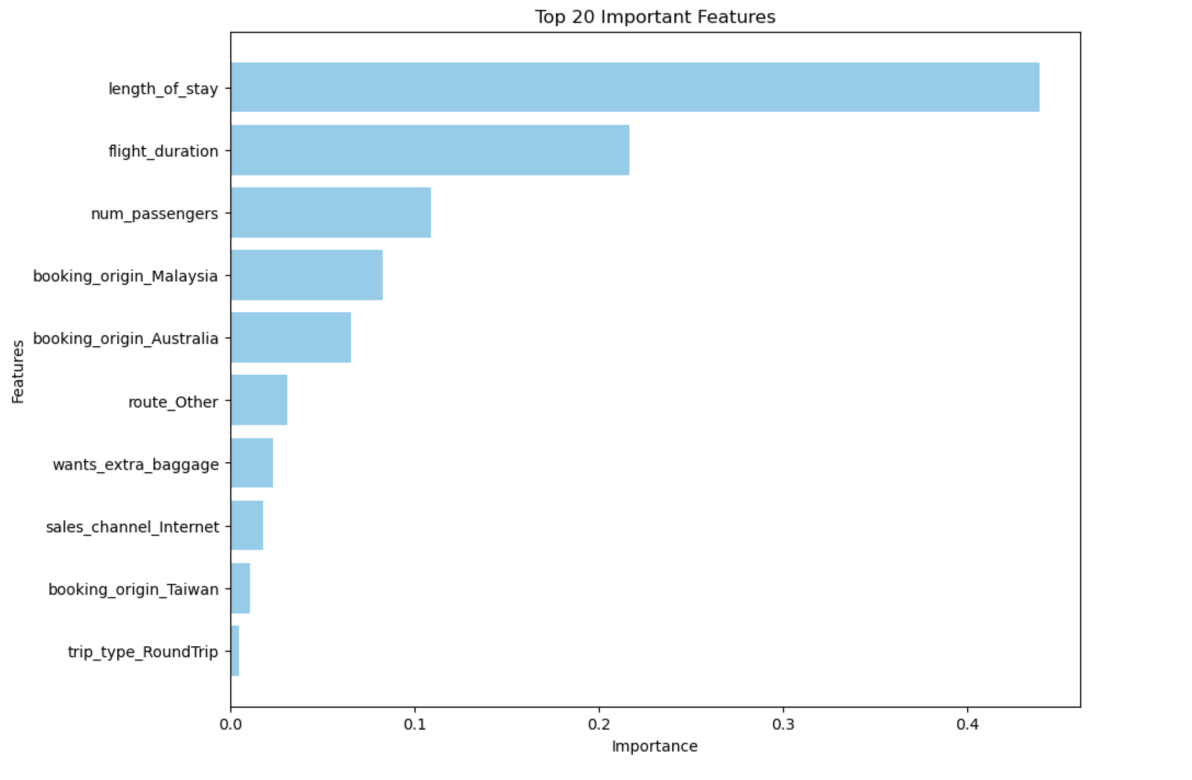
RESULTS
The model has an overall accuracy of approximately 83.5%, which indicates a generally good performance in predicting outcomes.
The recall for the minority class (1) is very low (0.16), suggesting that the model struggles to identify true positive cases of bookings, which could be due to class imbalance or insufficient discriminative features.
The most important features influencing the model's predictions include length_of_stay, flight_duration, and num_passengers, which suggests that trip characteristics significantly impact the likelihood of booking completion.

